Slide 2
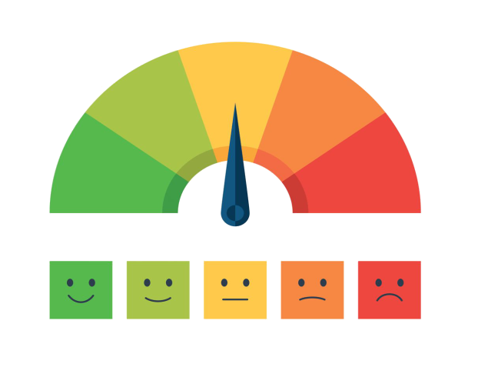
This means different things on different days, because what we think and how we feel can change all of the time.
Mental health is a spectrum.
It’s a part of our physical health and it is how we think, feel, how we cope, it’s our confidence and how we react to negative or stressful situations.
What is mental health?
Notes:
Questions to ask YP’s:
What is mental health.
Is mental health different to physical health?
What are some examples of mental health?
Use this slide to introduce MH as a spectrum and something that everyone has … like physical health

Slide 3
Mental health as a spectrum
This person may have a diagnosed condition, but very positive well-being because they are investing in self-care.
This person pays close attention to their self care, they also adapt it as they as need and they have no diagnosed mental health condition.
Lot’s of
self-care
A diagnosed mental health condition
No diagnosed mental health condition
This person has no diagnosed mental health condition, but they do not spend much time focusing on self care and their mental health may suffer.
This person may have a diagnosed condition, but they do not invest in self care. As a result their mental health may suffer.
Only a little
self-care
Notes:
This framework is an easy way for YP’s to visual the transience of our personal MH experiences.
Use this slide to introduce why self care is important.
Note: highlight here that X axis of this framework shows that even those of us without a diagnosed MH condition can have a less positive relationship with our mental health (Bottom right section)

Slide 4
What is self care and how can we do it?
Work on Time management
Breaking down the situation
Pep talks & daily mantras
Taking a bath
Try out journaling to track your feelings and what effects them.
Asking for support
Write an article, poem or short story on
Establish boundaries
Create a to-do list/ vision board
Meditation/mindfulness
Looking after a plant or pet
Reach out on through forums or speak to Kooth staff for some advice.
Take part in some mini-activities and get involved with the Kooth online community.
Exercise or playing sports
Journalling
Notes:
Ask YP’s for some examples of self care activities.
Those in white bubbles are general self-care tips. Cherry pick a few to explain in further detail.
Those in yellow bubbles are self care activities that can be done on Kooth.com

Slide 5
What is Kooth?
Completely anonymous!
Supports you with wellbeing.
Understanding and supportive.
Counselling and mentoring.
Tonnes of self-help resources.
There’s nothing too big, or too small, for Kooth to support with!
Notes:
Briefly summarise who Kooth are, what we do and how we can help.
Please specify the available age range in this slide.

Slide 6
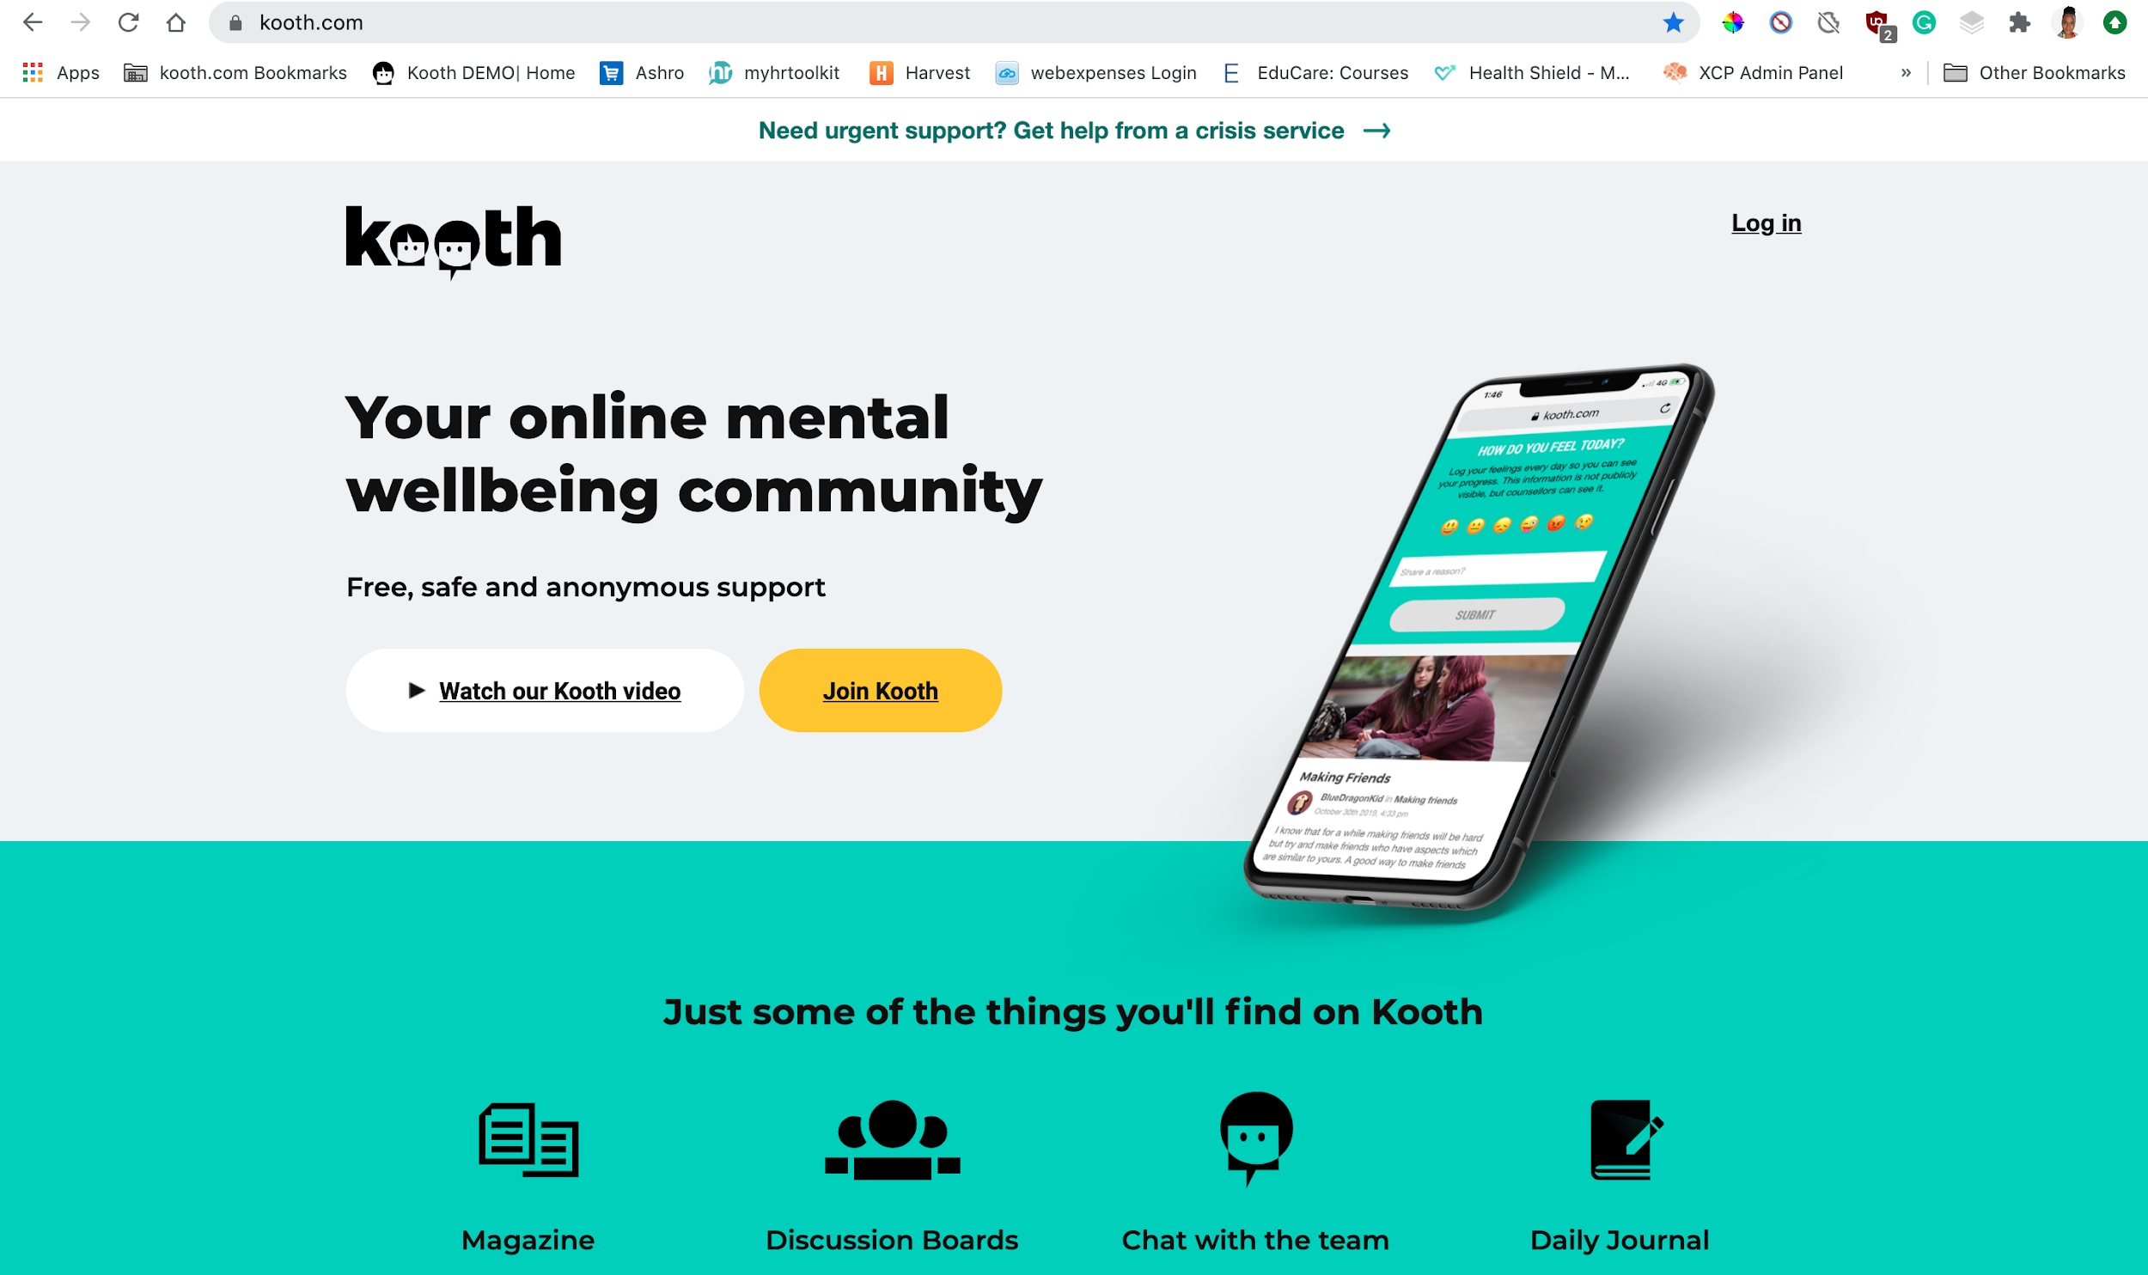
How to sign up to Kooth.com
Notes:
Direct young people to the Kooth website.
You can also take this opportunity to play the Kooth video available on the landing page whilst YPs are navigating here.

Slide 7
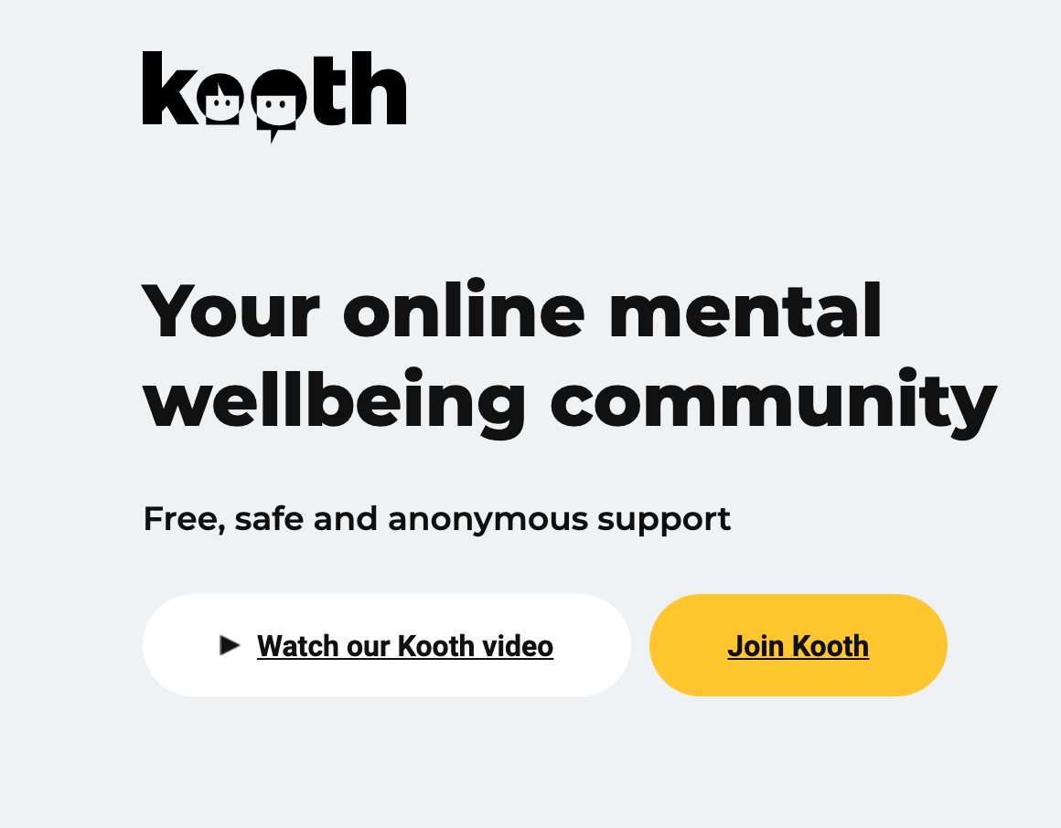
How to sign up to Kooth.com
Notes:
Direct YP’s to the Join Kooth button

Slide 8
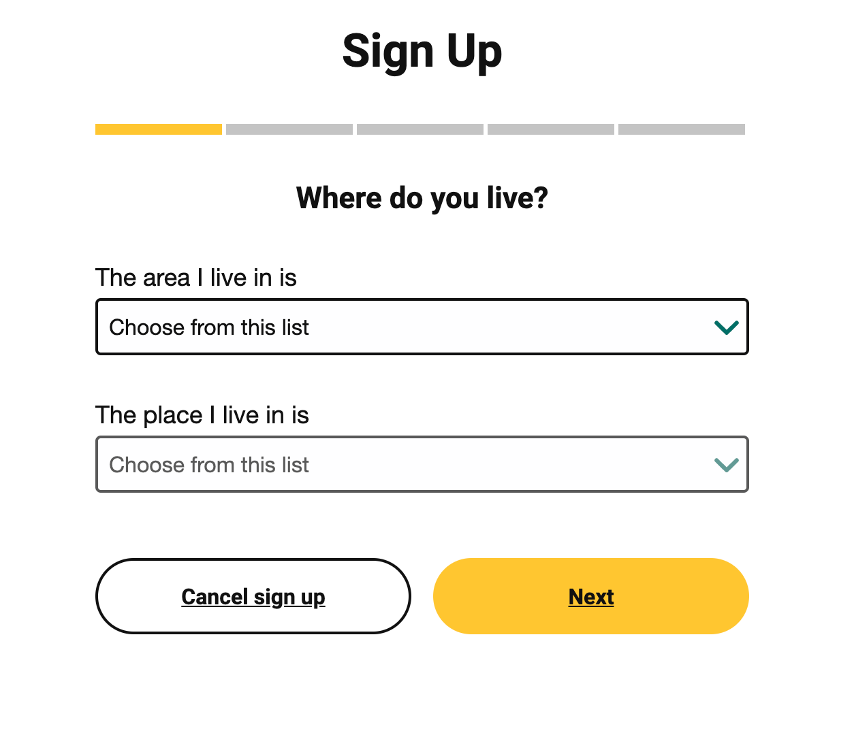
How to sign up to Kooth.com
Notes:
Ensure YP’s sign up under the correct areas.

Slide 9
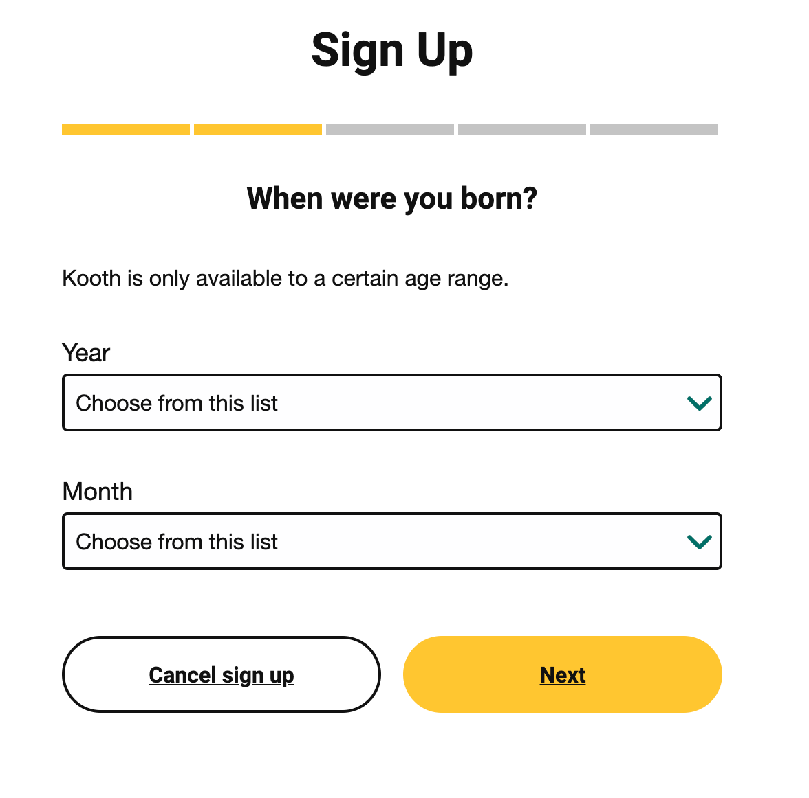
How to sign up to Kooth.com
Notes:
This page highlights the age range Kooth is available in your area.
Use this time to highlight how long YP’s can use the service in their area from

Slide 10
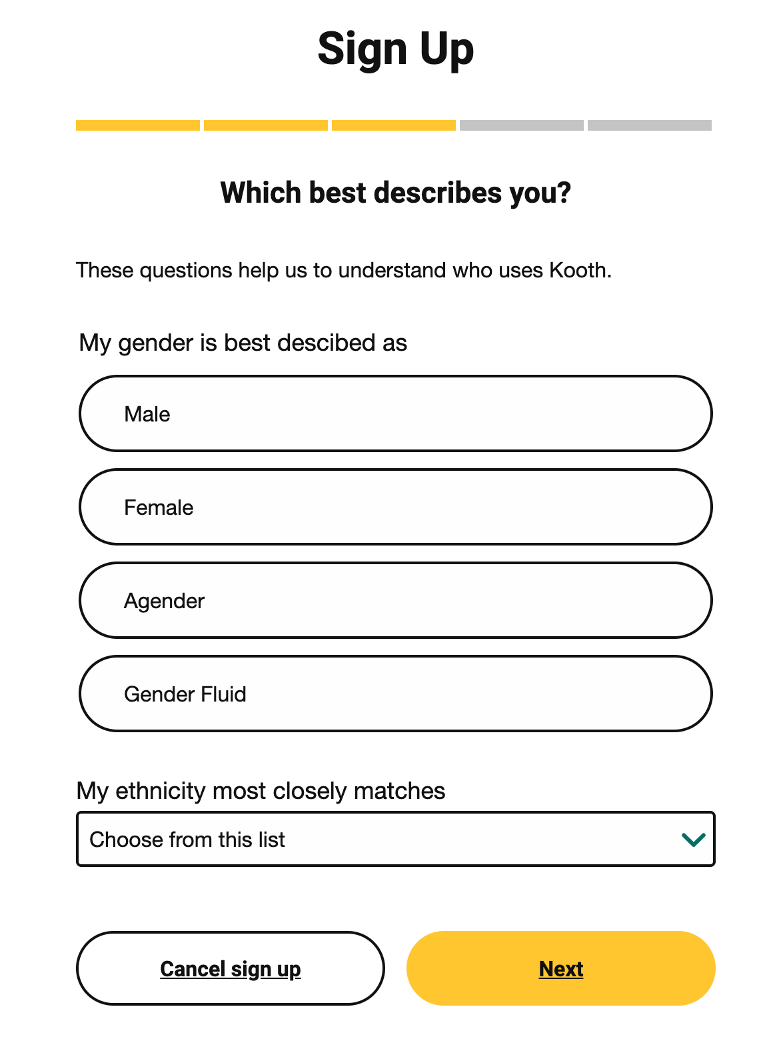
How to sign up to Kooth.com
Notes:
Gender and ethnicity often prompt questions from younger YP’s.
AGENDER: a person who does not identify themselves as having a particular gender
GENDER FLUID: a person who does not identify themselves as having a fixed gender.
ETHNICITY: your family heritage/race.

Slide 11
How to sign up to Kooth.com
Notes:
Support YP’s in selecting a username and password.
Remind YP’s that they should not use social media handles/gamer tags or any other identifiable names/nicknames
Remind YP’s that they need to pick a memorable password because we cannot send password reminders.
TIP: ask the teachers (ahead of the session of possible) to provide each YP with a post-it note so they can cover their usernames so their accounts can stay anonymous

Slide 12
Find a magazine article about...
Notes:
Once YP’s have signed up, explain how Kooth magazine works.
ACTIVITY: Find an article about - ADHD/bullying/your favourite hobby etc.
TIP: if you can prepare ahead, you can send Kooth pens/fidget toys etc to the classroom teacher before the session. These activities can be set as mini-competitions to keep YP’s engaged - the First YP to complete the activity wins a prize.

Slide 13
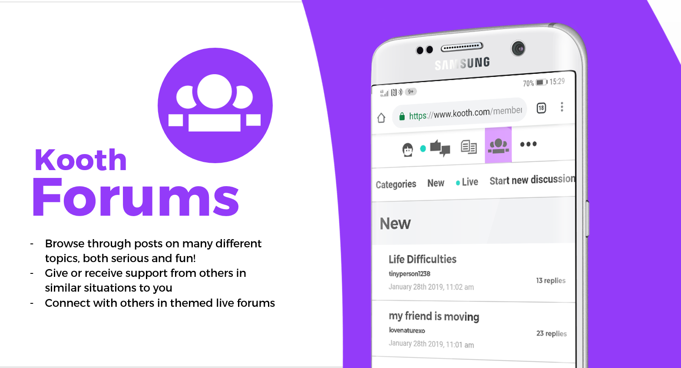
Find a forum that talks about...
Notes:
Once YP’s have signed up, explain how Kooth Forums work
ACTIVITY: Find a forum about - ADHD/bullying/your favourite hobby etc.
TIP: if you can prepare ahead, you can send Kooth pens/fidget toys etc to the classroom teacher before the session. These activities can be set as mini-competitions to keep YP’s engaged - the First YP to complete the activity wins a prize.

Slide 14
Find a mini- activity that helps with...
Kooth
Activities
Find mini-activities to help with building healthy habits and more!
Speak to others about how the activities worked for you.
Try them in your own time, away from screens.
Notes:
Once YP’s have signed up, explain how Kooth mini-activities work.
ACTIVITY: Find the mini-activity for three of the icons on this slide.
TIP: if you can prepare ahead, you can send Kooth pens/fidget toys etc to the classroom teacher before the session. These activities can be set as mini-competitions to keep YP’s engaged - the First YP to complete the activity wins a prize.

Slide 15
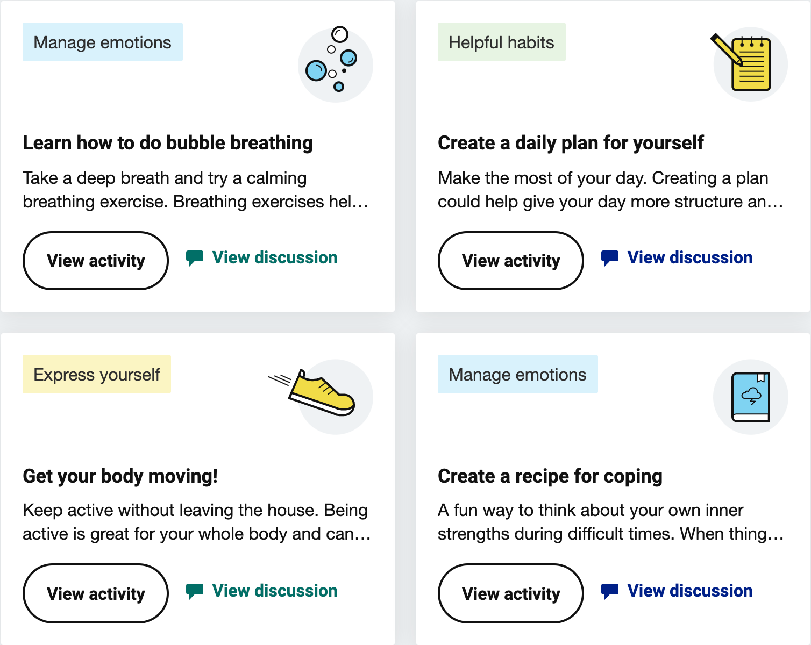
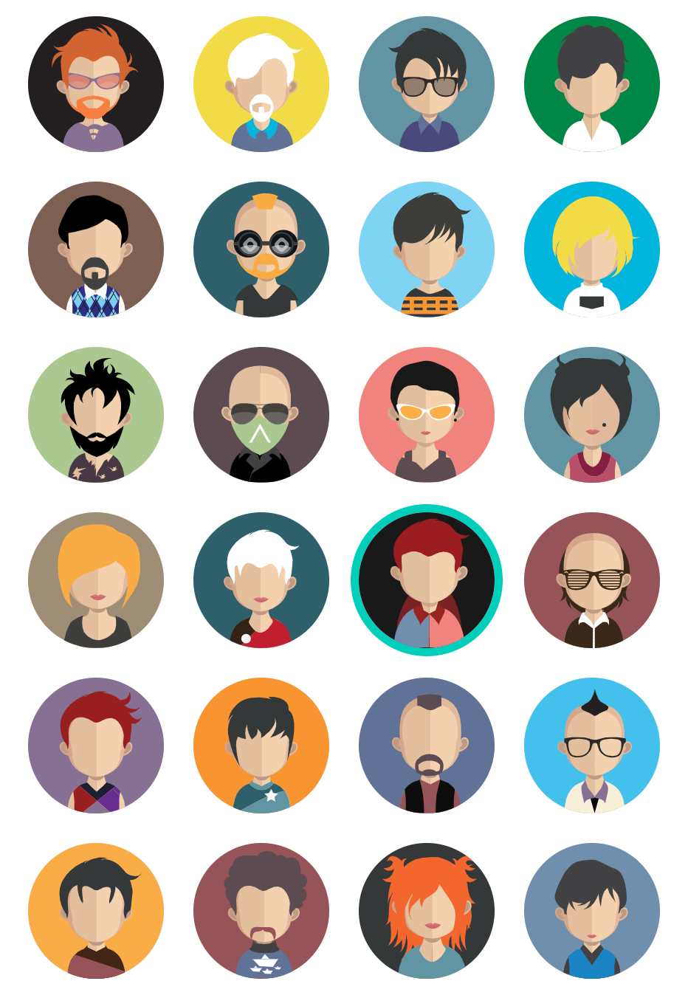
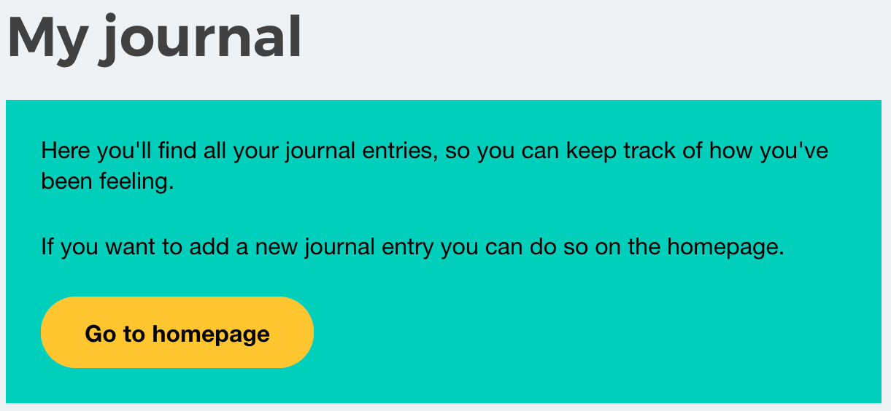
Activities on Kooth.
Create a journal entry on your feed and find it in the “My journal” space.
Find a mini-activity that you can try at home.
Change the avatar on your Kooth account.
Notes:
Additional activities to use if you have extra time in your session.,
Create a journal entry and find where these are saved on your Kooth account.
Find a mini-activity you can try at home this evening.
Figure out how to change your avatar on Kooth.

